Slide 1
OPERATING SYSTEMS
Razi Uddin
Lecture # 24

Slide 2


MULTIPROGRAMMING WITH VARIABLE TASKS (MVT)
Job can move (might be swapped back in a different place).
This is dynamic address translation (during run time).
Must perform an addition on every memory reference (i.e. on every address translation) to add the start address of the partition.
Eliminates internal fragmentation.
Find a region the exact right size (leave a hole for the remainder).
Not quite true, can't get a piece with 10A755 bytes. Would get say 10A760.
But internal fragmentation is much reduced compared to MFT.
Indeed, we say that internal fragmentation has been eliminated.

Slide 3
MULTIPROGRAMMING WITH VARIABLE TASKS (MVT)
This is the generalization of the fixed partition scheme.
It is used primarily in a batch environment. T
his scheme of memory management was first introduced in IBM OS/MVT (multiprogramming with a varying number of tasks).
Both the number and size of the partitions change with time.
Job still has only one segment (as with MFT) but now can be of any size up to the size of the machine and can change with time.
A single ready list.
Job can move (might be swapped back in a different place). This is dynamic address translation (during run time).
Must perform an addition on every memory reference (i.e. on every address translation) to add the start address of the partition.
Eliminates internal fragmentation.
Find a region the exact right size (leave a hole for the remainder).

Slide 4
MULTIPROGRAMMING WITH VARIABLE TASKS (MVT)
Introduces external fragmentation, i.e., holes outside any region.
What do you do if no hole is big enough for the request?
Solution—Can compact memory

Slide 5
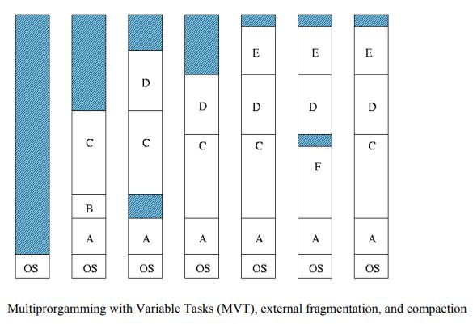
MULTIPROGRAMMING WITH VARIABLE TASKS (MVT)

Slide 6
EXTERNAL FRAGMENTATION
As processes come and go, holes of free space are created in the main memory.
External Fragmentation—refers to the situation when free memory space exists to load a process in the memory but the space is not contiguous.
Compaction eliminates external fragmentation by shuffling memory contents (processes) to place all free memory into one large block.
The cost of compaction is slower execution of processes as compaction takes place.

Slide 7
PAGING
All programs and data are composed of fixed-length units called pages i.e. logical memory is divided into blocks of the same size, called pages.
A block of words that occupy contiguous locations in main memory.
Constitute a basic unit of information that is transferred between the main memory and the disk.
Pages should not be too small.
Takes a considerable amount of time to locate the data on the disk.
Pages should not be too large.
Substantial portion of a page may not be used.
An area in the main memory that can hold one page is called a page frame i.e., Physical memory is broken down into fixed-sized blocks, called frames.

Slide 8
PAGING
It is important to keep track of all free frames.
In order to run a program of size n pages, we find n free frames and load program pages into these frames.
In order to keep track of a program’s pages in the main memory a page table is used.
The size of a page is a power of 2, the typical page table size lying between 1K and16K.
Every logical address generated by the CPU is divided into two parts:
Page number (p) (high-order bits)
And a page offset (d). (low-order bits)

Slide 9
PAGING
Information about main memory location of each page is kept in a page table.
Each entry in the page table includes some control bits:
One bit indicates the validity of the page.
Another bit indicates whether the page has been modified.
Other control bits indicate various restrictions that may be imposed on accessing the page.

Slide 10
PAGING
The page table contains the base address (frame number) of each page in physical memory.
The frame number is combined with the page offset to obtain the physical memory address of the memory location that contains the object addressed by the corresponding logical address.
Here p is used to index the process page table; page table entry contains the frame number, f, where page p is loaded.
The physical address of the location referenced by (p,d) is computed by appending d at the end of f, as shown below:
f | d

Slide 11
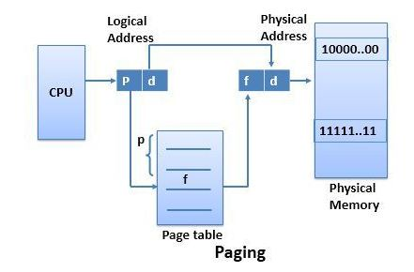
PAGING

Slide 12
Example: Assume a logical address space of 16 pages of 1024 words, each mapped into a physical memory of 32 frames.
No. of bits needed for p =ceiling[ log16] 2^4=4bits
No. of bits needed for f = ceiling[ log32] 2^5=5bits
No. of bits needed for d = 2048bytes =2^11
Logical address size = |p|+|d|=4+11=15bits
Physical address size =|f|+|d|=5+11=16bits
Page Table Size—Page table size = NP * PTES, (assuming a byte size page table entry)
where NP is the number of pages in the process address space and PTES is the page table entry size (equal to |f|)

Slide 13
16-bit logical address
2^16
8K page size
Maximum pages in a process address space =
2^16/8K=8pages
|d| = log2 8K =13bits
|p| = 16-13=3bits

Slide 14
Example
Logical address = 32-bit
Process address space = 2³² B = 4 GB
Main memory = RAM = 512 MB
Page size = 4K
Maximum pages in a process address space = 2^32/4K=1M
|d| =32-20=12bits
|p| = ceiling[log1M]=20bits
No. of frames = 512MB/4K =128K
|f| = ceiling[log128K]=17bits
Physical address = |f|+|d|=17+12=29bits

Slide 15


Virtual Memory

Slide 16
VIRTUAL MEMORY
Virtual Memory is the separation of user logical memory from physical memory.
This separation allows an extremely large virtual memory to be provided for programmers when only a smaller physical memory is available.
Virtual memory makes the task of programming easier because the programmer need not worry about the amount of physical memory, or about what code can be placed in overlays; she can concentrate instead on the problem to be programmed.
Virtual memory also allows files and memory to be shared by several different processes through page sharing.
The sharing of pages further allows performance improvements during process creation.
Virtual memory is commonly implemented as demand paging.
It can also be implemented in a segmentation system.
One benefit of virtual memory is efficient process creation.
Yet another is the concept of memory-mapped files

Slide 17
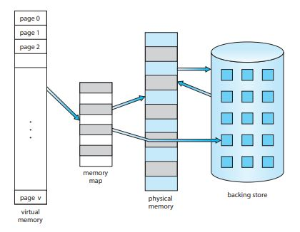
VIRTUAL MEMORY

Slide 18
DEMAND PAGING
A demand paging system is similar to a paging system with swapping.
Processes reside on secondary memory (which is usually a disk).
When we want to execute a process, we swap it into memory.
Rather than swapping the entire process into memory, however, we use a lazy swapper.
A lazy swapper never swaps a page into memory unless that page will be needed.
Since we are now viewing a process as a sequence of pages rather than as one large contiguous address space, use of swap is technically incorrect.
A swapper manipulates entire processes, whereas a pager is concerned with the individual pages of a process.
Thus the term pager is used in connection with demand paging.

Slide 19
DEMAND PAGING
When a process is to be swapped in, the paging software guesses which pages would be used before the process is swapped out again.
Instead of swapping in a whole process, the pager brings only those necessary pages into memory.
Thus it avoids reading into memory pages that will not be used anyway, decreasing the swap time and the amount of physical memory needed.
With this scheme, we need some form of hardware support to distinguish which pages are in memory and which are on disk.
Valid-invalid bit can be used for this purpose.

Slide 20
DEMAND PAGING
This time however when the bit is set to valid, this value indicates that the associated page is both legal and in memory.
If the bit is set to invalid this value indicates that the page either is invalid (that is, not in the logical address space of the process) or valid but currently on the disk.
The page table entry for a page that is brought into memory is set as usual but the page table entry for a page that is currently not in memory is simply marked invalid or contains the address of the page on disk.
Notice that marking a page invalid will have no effect if the process never attempts to access that page.

Slide 21
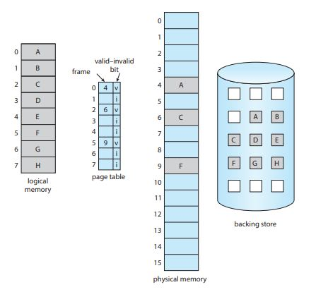
DEMAND PAGING

Slide 22
PAGE FAULT
What happens if the process tries to access a page that was not brought into memory?
Access to a page marked invalid causes a page fault trap.
The paging hardware in translating the address through the page table will notice that the invalid bit is set, causing a trap to the operating system.
The procedure for handling a page fault is straightforward:
We check an internal table (usually kept with the process control block) for this process to determine whether the reference was valid or invalid memory access.
If the reference was invalid we terminate the process. If it was valid, but we have not yet brought in that page, we now page it in.

Slide 23
PAGE FAULT
We find a free frame (by taking one from the free-frame list, for example)
We schedule a disk operation to read the desired page into the newly allocated frame.
When the disk read is complete, we modify the internal table kept with the process and the page table to indicate that the page is now in memory.
We restart the instruction that was interrupted by the illegal address trap.
The process can now access the page as though it had always been in memory.

Slide 24
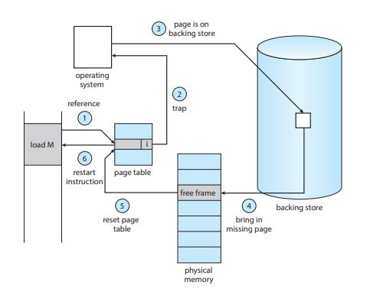
PAGE FAULT

Slide 25
PAGE FAULT
A crucial requirement for demand paging is the ability to restart any instruction after a page fault.
Since we save the state (registers, condition code, instruction counter) of the interrupted process when the page fault occurs, we can restart the process in exactly the same place and state except that the desired page is now in memory and is accessible.
In this way we are able to execute a process even though portions of it are not yet in memory.
When the process tries to access locations that are not in memory, the hardware traps the operating system (page fault).
The operating system reads the desired into memory and restarts the process as though the page had always been in memory.

Slide 26
PAGE FAULT
In the extreme case, we could start executing a process with no pages in memory.
When the operating system sets the instruction pointer to the first instruction of the process, which is on a non-memory resident page, the process immediately faults for the page.
After this page is brought into memory, the process continues to execute faulting as necessary until every page that it needs is in memory.
At that point, it can execute with no more faults.
This scheme is called pure demand paging: never bring a page into memory until it is required.

Slide 27
PAGE FAULT
The hardware needed to support demand paging is the same as the hardware for paging and swapping:
Page table—This table has the ability to mark an entry invalid through a valid invalid bit or special value of protection bits.
Secondary memory—This memory holds those pages that are not present in the main memory.
The secondary memory is usually a high-speed disk.
It is known as the swap device, and the section of disk used for this purpose is called the swap space.

